Slide 1
Integration SSM
2013/12/16
Sam Chen

Slide 2
agenda
What is SSM?
Sample demo
How to integrate SSM
2013/12/16

Slide 3
What is SSM?
Struts
Spring
MyBatis
2013/12/16

Slide 4
Struts
2013/12/16
MVC framework

Slide 5
Struts
是一種 MVC(Model-View-Controller) framework
  Model: JavaBean, Business logic
  View: JSP page
  Controller: Action class
2013/12/16

Slide 6
Spring
2013/12/16
DI(Dependency Injection)/IoC(Inversion of Control)

Slide 7
Spring
容器（Container）
  Spring 核心本身是個容器，管理物件的生命週期、物件的組態、相依注入(Dependency Injection)等，並可以控制物件在創建時是以原型（Prototype） 或 單例（Singleton） 的方式來建立。
IoC（Inversion of Control）
  Spring 的核心概念是IoC，更具體而易懂的名詞是依賴注入（Dependency Injection），使用 Spring，您不必自己在程式碼中維護物件的依賴關係，只需在組態檔中加以設定，Spring 核心容器會自動根據組態將依賴注入指定的物件。
2013/12/16

Slide 8
MyBatis3
2013/12/16
persistence framework

Slide 9
Mybatis
MyBatis 可以透過 XML 或是註解(annonation)的方式設定，減少 JDBC 程式碼、參數拼接與執行結果的 Coding
Custom SQL
Stored Procedures
Advanced Mappings
2013/12/16

Slide 10
Demos
2013/12/16
每個 Framework 的小範例 demo

Slide 11
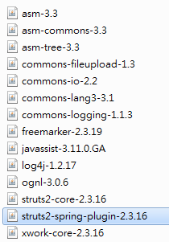
Struts
Demo version
  struts-2.3.16
Dependency libraries
2013/12/16

Slide 12
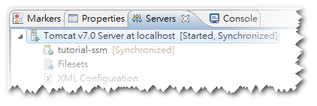
Struts
Add tutorial-ssm to tomcat server
Start tomcat server
Open URL http://localhost/tutorial-ssm
2013/12/16

Slide 13
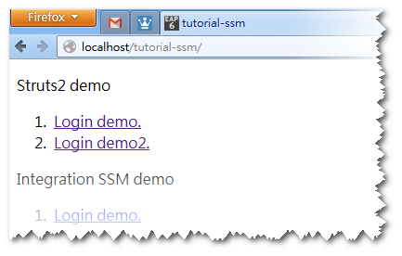
Struts
2013/12/16

Slide 14
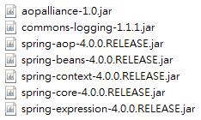
Spring
Demo version
  spring-framework-4.0.0
Dependency libraries
2013/12/16

Slide 15
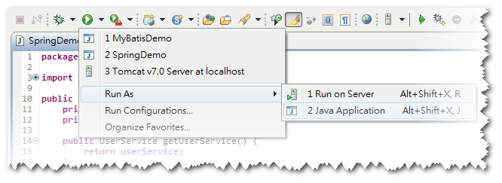
Spring
Open tutorial.demo.SpringDemo.java
Run as Java Application
2013/12/16

Slide 16
MyBatis
Demo version
  mybatis-3.2.3
Dependency libraries
2013/12/16

Slide 17
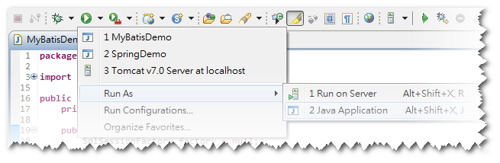
MyBatis
Open tutorial.demo.MyBatisDemo.java
Run as Java Application
2013/12/16

Slide 18

How to integrate SSM
Prepare libraries
2013/12/16

Slide 19
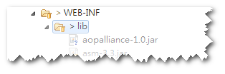
How to integrate SSM
Use eclipse create an Dynamic Web Project
Put all libraries into project’s WEB-INF/lib
2013/12/16

Slide 20
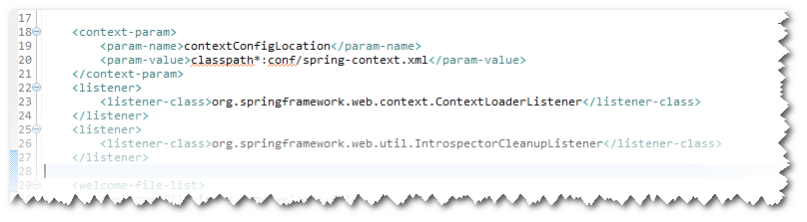
How to integrate SSM
Spring + MyBatis
  tutorial/demo.SpringMybatis.java
  conf/spring-mybaits.xml
Spring + Struts
  tutorial/struts-spring.xml
  Add spring to web.xml
2013/12/16

Slide 21
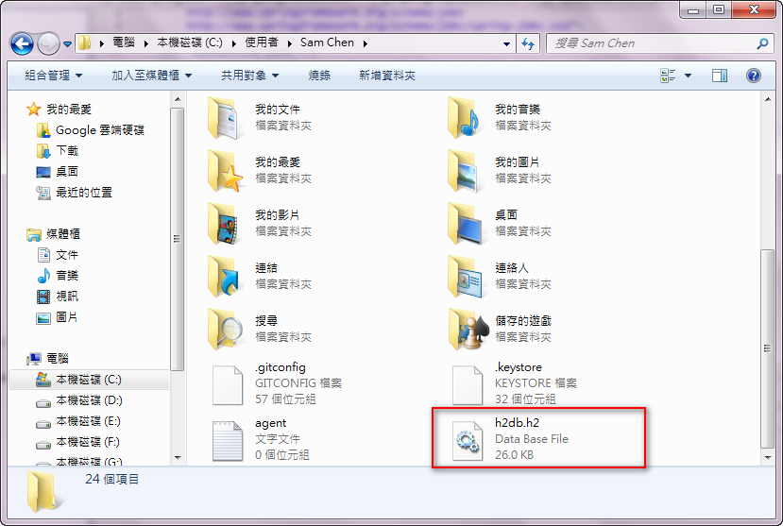
How to integrate SSM
Copy GIT project’s database/h2db.h2.db to windows user home directory
2013/12/16

Slide 22
附錄
Git project
  https://github.com/dershiuan/tutorial-ssm.git
Framework 官網
  Struts: http://struts.apache.org/
    http://repo.springsource.org/release/
  Spring: http://spring.io/
  MyBatis: https://github.com/mybatis/
    mybatis-3
    mybatis-spring
Reference
  良葛格: http://openhome.cc/Gossip/
    Servlet/JSP
    Struts
    Spring
2013/12/16

